Slide 1

PROPOSITIONAL LOGIC
Syntactic Approach

Slide 2

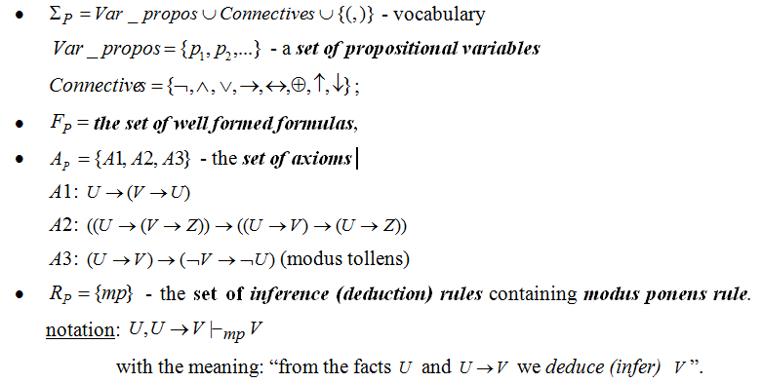
AXIOMATIC (FORMAL) SYSTEM:

Slide 3
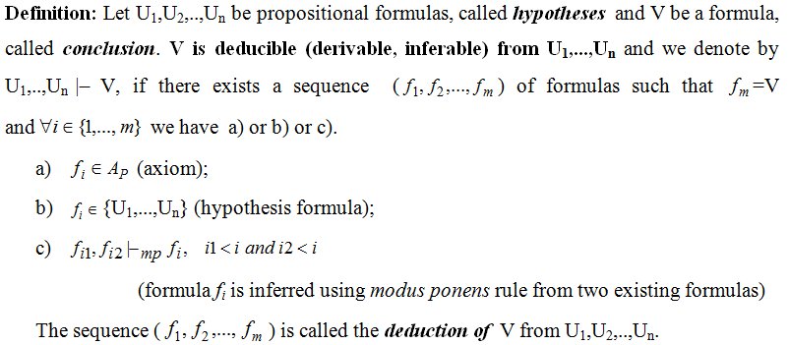
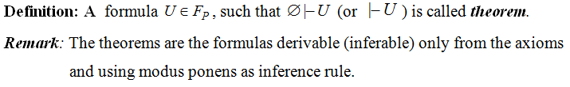
DEDUCTION

Slide 4
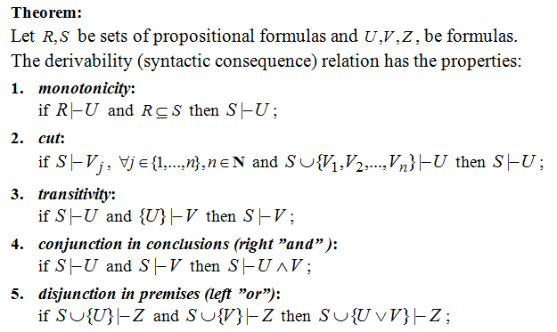
PROPERTIES OF DERIVABILITY RELATION

Slide 5
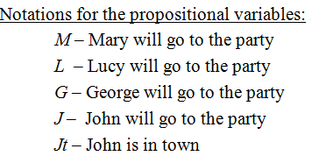
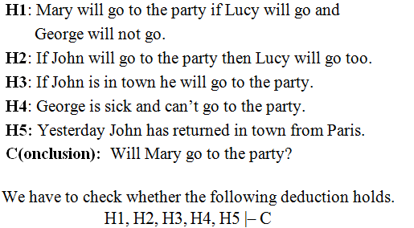
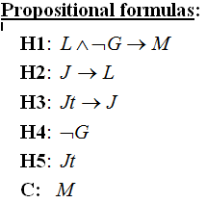
EXAMPLE 1 OF REASONING MODELING: PARTY

Slide 6
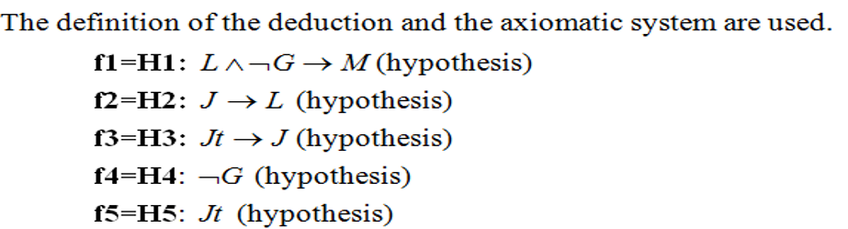




Slide 7
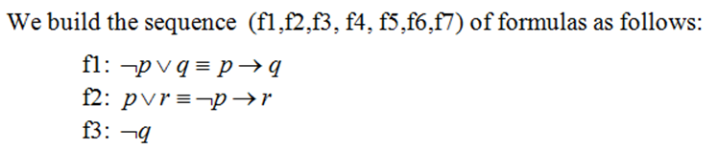

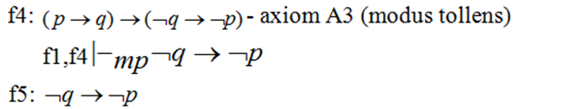
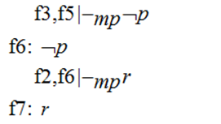
EXAMPLE 2

Slide 8
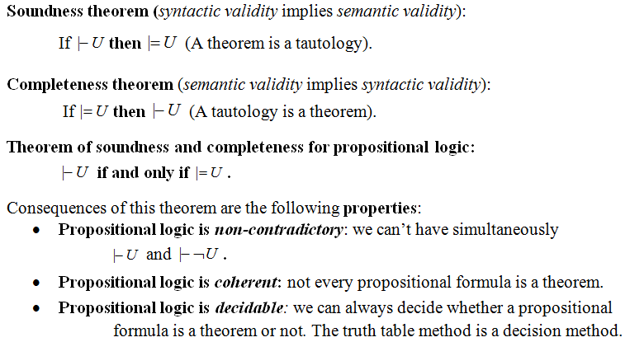
PROPERTIES OF PROPOSITIONAL LOGIC

Slide 9
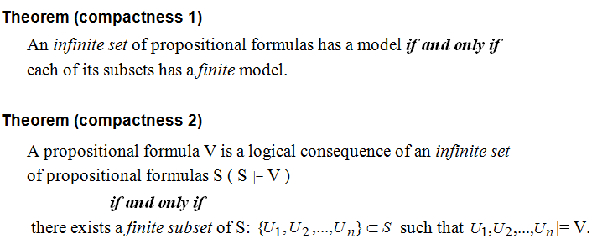
COMPACTNESS PROPERTY

Slide 10
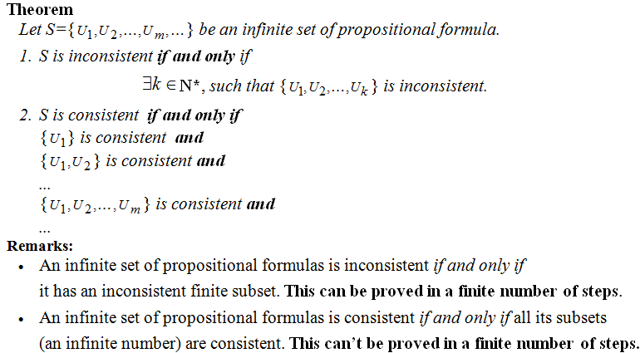
COMPACTNESS PROPERTY (CONTD.)

Slide 11
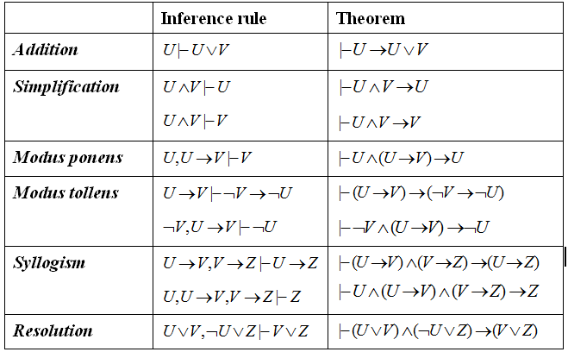
PROPOSITIONAL INFERENCE RULES

Slide 12
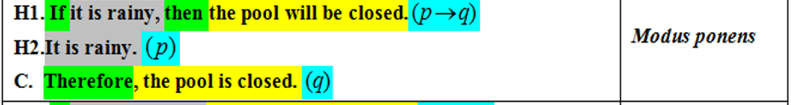
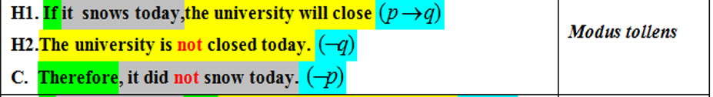
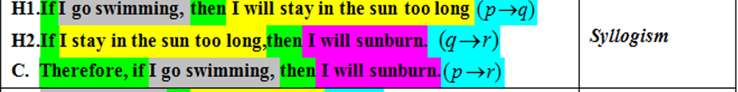
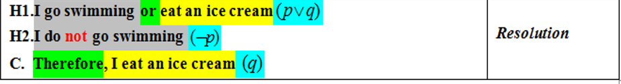
WHICH RULE OF INFERENCE IS USED IN EACH ARGUMENT BELOW?

Slide 13
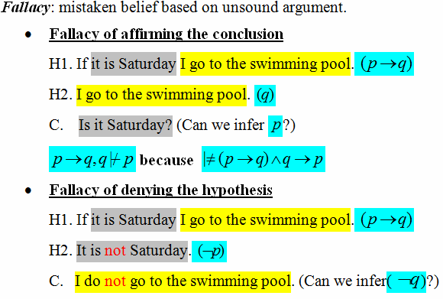
FALLACIES

Slide 14
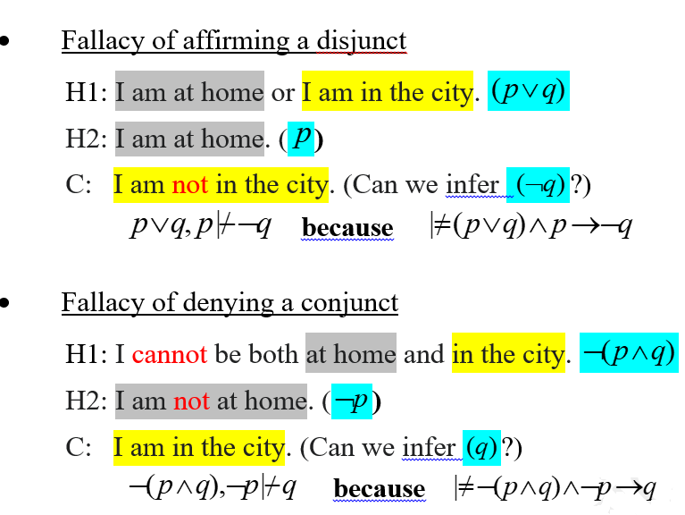
FALLACIES (contd.)

Slide 15

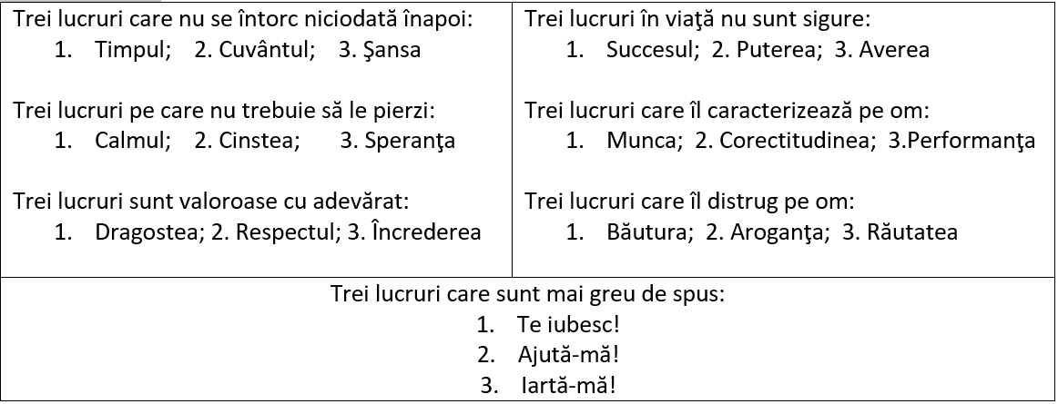
ÎNŢELEPCIUNE

Slide 16
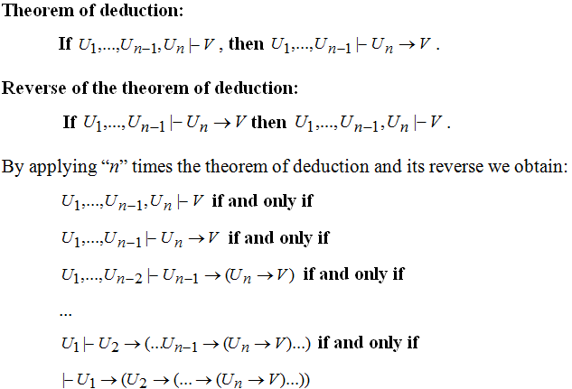
THEOREM OF DEDUCTION AND ITS REVERSE

Slide 17
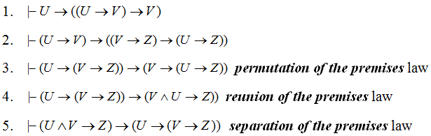
Theorem of deduction - consequences

Slide 18

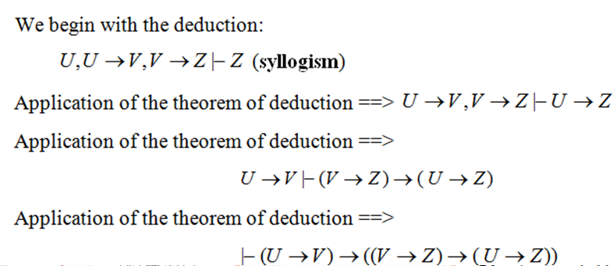
Proof

Slide 19
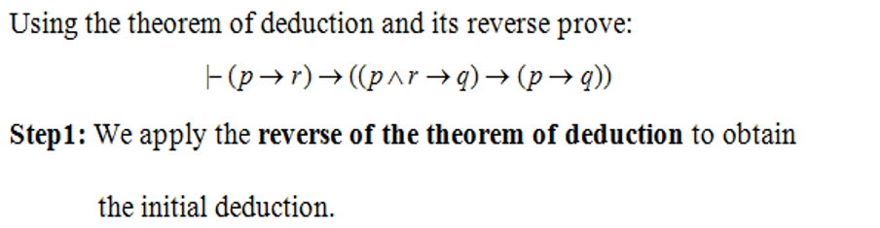
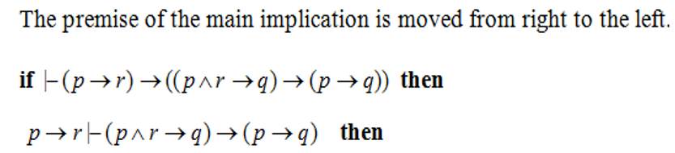

EXAMPLE 4 – THEOREM OF DEDUCTION

Slide 20
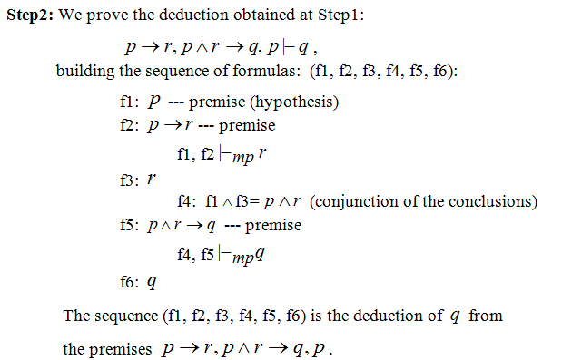
EXAMPLE 4 (CONTD.)

Slide 21
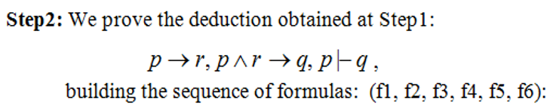





EXAMPLE 4 (CONTD.)

Slide 22
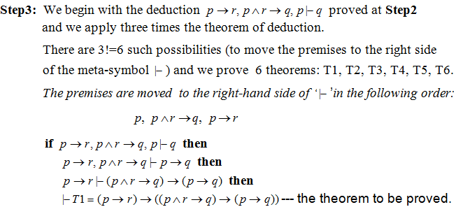
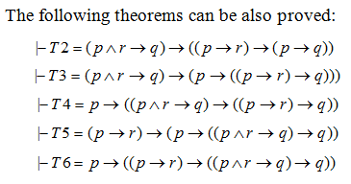
EXAMPLE 4 (CONTD.)

Slide 23
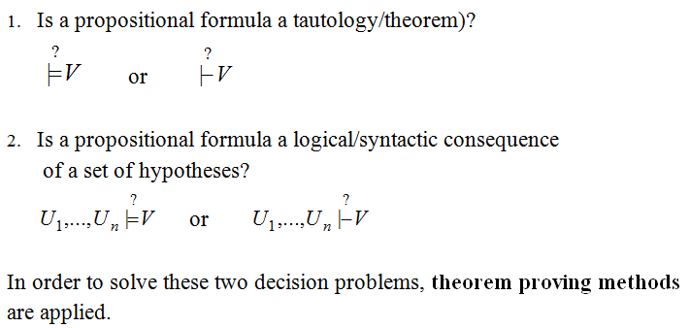
DECISION PROBLEMS IN PROPOSITIONAL LOGIC

Slide 24
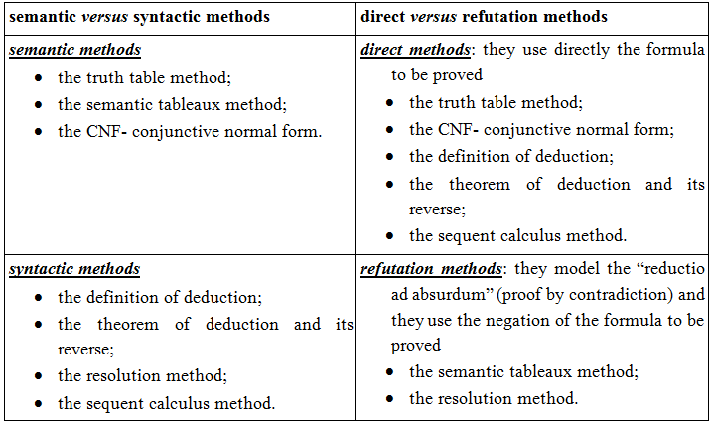
CLASSIFICATION OF PROOF METHODS

